Slide 1
Physics 2 – Mar 7, 2019
Get out p125 #1-12 for progress
HMK check
P3 Challenge – How much heat is needed to completely melt 150 g of ice initially at – 10C? (For water: L_{f} = 334 kJ/kg, L_{v} = 2260 kJ/kg, c_{ice} = 2200 J/kgK, c_{water} = 4184 J/kgK) Hint: watch your units.
Today’s Objective:
  3.1 Thermal Physics; Calorimetry
Assignment:
  Extra Calorimetry Worksheet
  Download Option B pdf
Agenda
  Calorimetry
  Homework Answers only
  Time to work on #1-12 for Answer alignment on WBs
  Time to work on Extra set of problems

Slide 2
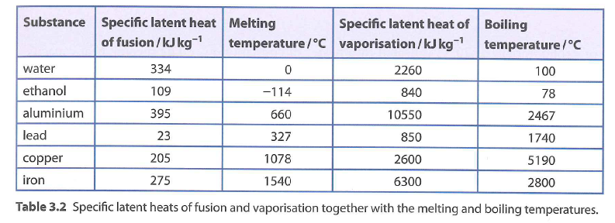
Heat during Phase changes
For the constant temperature phase changes, Q = mL
Where L is the specific latent heat of fusion for melting and freezing and
Or where L is the specific latent heat of vaporization for boiling and condensation.
The unit for L is J/kg or kJ/kg or J/g
Note the similarity between this equation and Q= mcT.

Slide 3
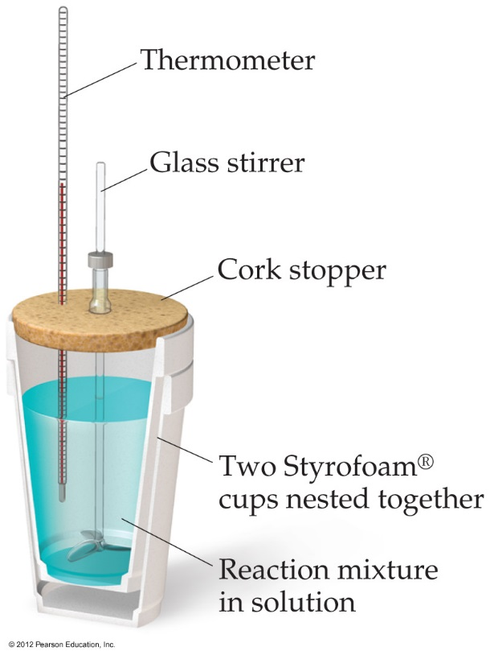
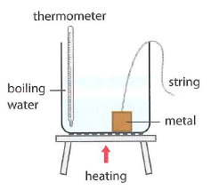
Calorimetry (method of mixtures)
Calorimetry is the measurement of heat.
In general, with any kind of calorimetry, there is some hot substance giving off heat and something else picking up that heat.
The amount of heat lost by the hot object = amount of heat gained by the cold object.
Either |Q_{c}| = |Q_{H}| or Q_{c}= - Q_{H}
Or to say it another way, the energy of the total system is conserved. Q_{c}+ Q_{H} =0
water

Slide 4
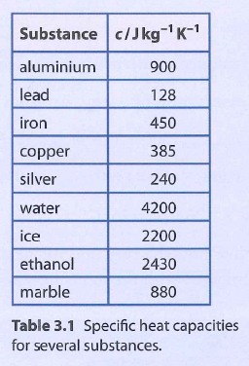
Calorimetry problem
A 525 g lead ball at a temperature of 100.0☑C is placed in a 25.0 g aluminum calorimeter containing 587.6 g of water at 17.5°C. Find the equilibrium temperature of the system. (approx. 20°C)

Slide 5
Homework Answers
1. a) Yes, Q_{C}= - Q_{H} . Energy is conserved for the system. B) T_{C} = - T_{H} only if the same material. Generally the two T are probably different.
2. a) 513 J/kgC b) same
3. 2.78 J/gC or 2780 J/kgK
4. 4.16 J/gC
5. 71.7 C or 72 K
6. a) 116 kJ/K b) 86.3 min
7. 31.6 g (watch units!!)
8. 3.84 x 10⁸J or 384, 000 kJ
9. a) 83.5 min b) Assume no reflection of light energy from the ice.
10. a) 22 kJ b) 334 kJ c) 41.8 kJ d) melting needs the most energy
11. 0.111 kg or 111 g
12. Hint: Assume the final temperature will be greater than 30C because of the large value of L_{v}.

Slide 6
Exit Slip - Assignment
Exit Slip- When a 350. g sample of an unknown metal at 85.0C is dropped into 480. g of water initially at 20.0C, the temperature of the water rises to 24.8C. What is the heat capacity of the metal? What is the likely identity of the metal?
What’s Due? (Pending assignments to complete.)
  Ch 3.1, p125, #1-12 Due Tuesday
What’s Next? (How to prepare for the next day)
  Read 3.1 p116- 124 about Thermal Energy

